Slide 1
SafeBite AI: An AI-Powered Food Safety & Authenticity Platform “Safe Food. Stronger Nation.”
CSE7101- Capstone Project
Review-1
Batch Number: CAI_
Under the Supervision of,
Dr. Suvanam Sasidhar Babu
Professor / Associate Professor / Assistant Professor
School of Computer Science and Engineering
Presidency University
Roll Number | Student Name
20221CAI0064 | ROHAN S KUMAR
Name of the Program: B.Tech.(CAI)
Name of the HoD: Dr. Zaffar Ali Khan
Name of the Program Project Coordinator: Ms. Suma N. G.
Name of the School Project Coordinators: Dr. Sampath A K , Dr. Geetha A

Slide 2
Problem Statement Number: PSCS 250
Organization: AICTE, MIC-Student Innovation
InnovationCategory (Hardware / Software / Both) : SOFTWARE
Problem Description:
Food adulteration in essentials like milk, oils, and spices poses severe health risks, while misinformation
on social media fuels panic and mistrust. Existing solutions are fragmented, costly, and inaccessible
to consumers. There is a need for a unified AI-powered platform that enables real-time
adulteration detection, validates food-related claims, and provides region-specific safety insights,
with future scalability for IoT and blockchain integration.

Slide 3
Content
Problem Statement
Objectives
Background and Related work for title Selection
Analysis of Problem Statement
Innovation or Novel Contributions
Git-hub Link
Timeline of the Project
References

Slide 4
Problem Statement
Food adulteration in everyday staples such as milk, oils, and spices poses significant health hazards and undermines consumer trust.
Accessible, real-time detection tools for consumers are lacking, while laboratory tests remain costly and impractical for widespread use.
Food-related misinformation spreads rapidly across digital platforms, fueling panic and confusion.
Existing solutions are fragmented, addressing isolated problems without offering a holistic, consumer-focused approach.
This highlights the urgent need for a unified AI-powered platform that ensures food safety by detecting adulteration, validating food-related claims, and delivering region-specific insights, with scalability for future IoT and blockchain integration.

Slide 5
Objectives
Our primary objectives are to:
Food Image Classification: Train CNN models (EfficientNet/ResNet/etc) to identify and categorize food items from images.
AI-Powered Chatbot: Build an intelligent chatbot (ALBERT) to handle queries, log geo-tagged complaints, and guide consumers.
Fake News Detection: Use transformer models (DistilBERT/RoBERTa) to verify and filter food-related misinformation.
Crowdsourced Risk Index: Develop a real-time regional heatmap of adulteration risks by aggregating consumer complaints and AI insights.

Slide 6
Background and Related Work
Food adulteration in essentials like milk, oils, and spices poses serious health risks, while costly lab tests restrict accessibility.
CNN models (EfficientNet, ResNet) excel in food classification; transformer models (BERT, RoBERTa, DistilBERT) advance misinformation detection.
IoT and blockchain show promise in food safety monitoring but remain fragmented and underutilized for consumers.
Critical Gap: Lack of a unified, real-time, consumer-focused platform to detect adulteration, counter misinformation, and provide regional risk insights.
Proposed Solution: SafeBite AI integrates image classification, chatbot, fake news detection, and a Crowdsourced Risk Index to ensure food safety.

Slide 7
Analysis of Problem Statement
Our project is built on a modern AI-powered web stack:
Frontend: ReactJS / Next.js for responsive web interface
Backend: FastAPI / Flask for API and model integration
AI Models: EfficientNet/ResNet (food classification), ALBERT (chatbot), DistilBERT/RoBERTa (fake news detection)
Database: MongoDB / Firebase for complaint and report storage
Visualization: Folium / Mapbox for real-time heatmaps

Slide 8
Analysis of Problem Statement (contd...)
Software and Hardware Requirements:
Software Requirements:
IDE: Visual Studio Code
Backend: Flask / FastAPI
Frontend: ReactJS / Next.js
Libraries: TensorFlow, PyTorch,
Hugging Face Transformers
Database: MongoDB / Firebase
Version Control: Git
Hardware Requirements:
Laptop with 8–16 GB RAM and
internet connection
GPU-enabled environment (e.g., Google
Colab Pro) for model training

Slide 9
Github Link
The Github link provided should have public access permission.
Github Link
https://github.com/RohanSKumar16/Capstone-Project-SafeBite-AI.git

Slide 10
Innovation or Novel Contributions
Crowdsourced Food Safety Risk Index : Real-time, region-specific adulteration risk mapping for proactive food safety alerts.
Comprehensive AI Solution : First platform to unify image classification, fake news detection, chatbot, and complaint reporting.
Consumer-Driven Intelligence : Leverages user-generated data to create actionable insights for individuals and authorities.
Scalable & Future-Oriented : Architecture designed for IoT integration, blockchain-enabled transparency, and mobile app expansion.

Slide 11
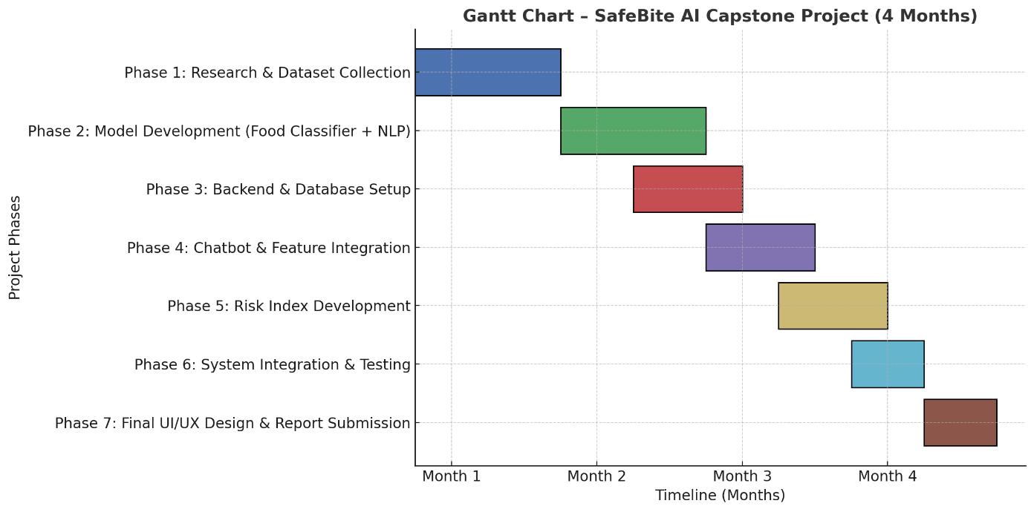
Timeline of the Project (Gantt Chart)

Slide 12
References (IEEE Paper format)
[1] R. U. Mhapsekar, L. Abraham, N. O’Shea, and S. Davy, “Edge-AI implementation for milk adulteration detection,” Proc. IEEE Global Conf. Artificial Intell. Internet Things (GCAIoT), pp. 108–113, Dec. 2022, doi: 10.1109/GCAIoT57150.2022.10019173.
[2] S. Peddareddigari, S. V. H. Vijayan, and M. Annamalai, “IoT, blockchain, big data and artificial intelligence (IBBA) framework — for real-time food safety monitoring,” Applied Sciences, vol. 15, no. 1, article 105, Dec. 2024, doi: 10.3390/app15010105.
[3] X. Zhou and R. Zafarani, “Fake news: A survey of research, detection methods, and opportunities,” IEEE Trans. Knowl. Data Eng., vol. 33, no. 9, pp. 3579–3599, Sep. 2021, doi: 10.1109/TKDE.2020.2981314.

Slide 13


